Slide 1

Introduction to Operating Systems and Kernel
K L Deemed to be University Department of Computer Science and Engineering
19CS2106S & 19CS2106A Operating Systems Design
Mr. Vishnuvardhan Mannava Course Coordinator
Topics
Course Handout
Introduction to Operating Systems
Kernel Architecture
Questions answered in this lecture:
What will you do in this course?
What is an OS and why do you want one?
Why study operating systems?
What is a kernel?

Slide 2
What is an Operating System?
Not easy to define precisely…
Users
Applications
Operating System
Hardware
Operating System (OS): Software that converts hardware into a useful form for applications

Slide 3
What DOES OS Provide?
Role #1: Abstraction - Provide standard library for resources
What is a resource?
Anything valuable (e.g., CPU, memory, disk)
What abstraction does modern OS typically provide for each resource?
CPU:
process and/or thread
Memory:
address space
Disk:
files
Advantages of OS providing abstraction?
Allow applications to reuse common facilities
Make different devices look the same
Provide higher-level or more useful functionality
Challenges
What are the correct abstractions?
How much of hardware should be exposed?

Slide 4
What DOES OS PROVIDE?
Role #2: Resource management – Share resources well
Advantages of OS providing resource management?
Protect applications from one another
Provide efficient access to resources (cost, time, energy)
Provide fair access to resources
Challenges
What are the correct mechanisms?
What are the correct policies?

Slide 5
The Core Operating System: The Kernel
The term operating system is commonly used with two different meanings:
To denote the entire package consisting of the central software managing a computer’s resources and all of the accompanying standard software tools, such as command-line interpreters, graphical user interfaces, file utilities, and editors.
More narrowly, to refer to the central software that manages and allocates computer resources (i.e., the CPU, RAM, and devices).
The kernel is the central module of an operating system (OS). It is the part of the operating system that loads first, and it remains in main memory. Because it stays in memory, it is important for the kernel to be as small as possible while still providing all the essential services required by other parts of the operating system and applications. The kernel code is usually loaded into a protected area of memory to prevent it from being overwritten by programs or other parts of the operating system.

Slide 6
The Core Operating System: The Kernel
Typically, the kernel is responsible for memory management, process and task management, and disk management. The kernel connects the system hardware to the application software.
Although it is possible to run programs on a computer without a kernel, the presence of a kernel greatly simplifies the writing and use of other programs and increases the power and flexibility available to programmers. The kernel does this by providing a software layer to manage the limited resources of a computer.
The Linux kernel executable typically resides at the pathname /boot/vmlinuz, or something similar. The derivation of this filename is historical. On early UNIX implementations, the kernel was called unix. Later UNIX implementations, which implemented virtual memory, renamed the kernel as vmunix. On Linux, the filename mirrors the system name, with the z replacing the final x to signify that the kernel is a compressed executable.

Slide 7
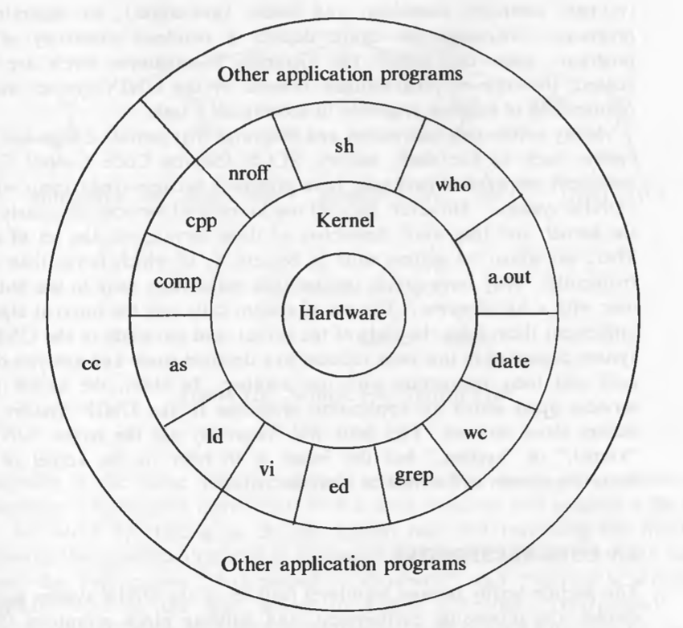
Unix Architecture
The operating systems interacts directly with the hardware, providing common services to programs and insulating them from hardware idiosyncrasies.
Programs such as the shell and editors shown in the outer layers interact with the kernel by invoking a well defined set of system calls.

Slide 8
Unix Family
Unix and Unix-like operating systems are a family of computer operating systems that derive from the original Unix System from Bell Labs which can be traced back to 1965.
Every operating system has a kernel. For example, the Linux kernel is used numerous operating systems including Linux, FreeBSD, Android and others. Mac OS X is based on BSD UNIX.
Linux is nothing but a UNIX clone which is written Linus Torvalds from scratch with the help of some hackers across the globe.
Linux is the most prominent example of a "real" Unix OS. It runs on anything and supports way more hardware than BSD or OS X.

Slide 9
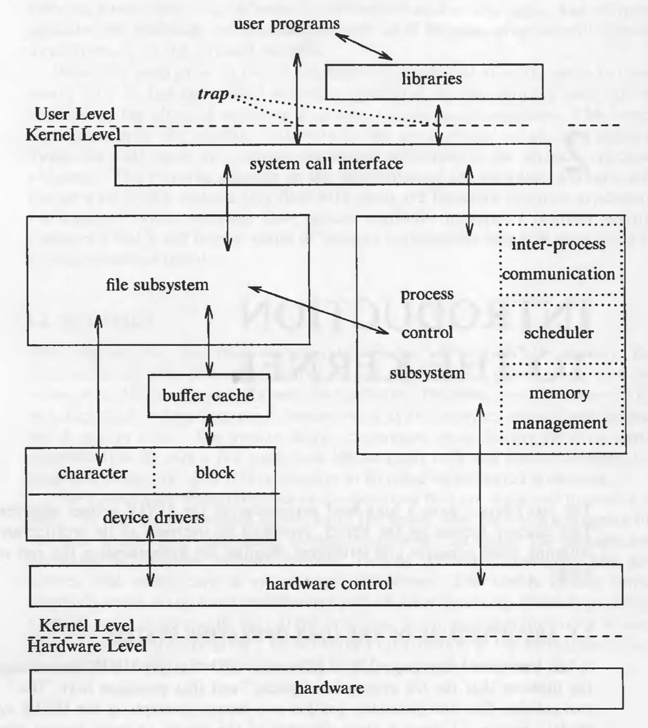
Unix system v6 Kernel
The two entities, files and processes, are the two central concepts in the UNIX system model.
The file subsystem is on the left and the process control subsystem is on the right.
The diagram shows 3 levels : user, kernel, and hardware.
The system call and library interface represent the border between user programs and the kernel.

Slide 10
Tasks performed by the kernel: Process scheduling:
Among other things, the kernel performs the following tasks:
Process scheduling: A computer has one or more central processing units (CPUs), which execute the instructions of programs. Like other UNIX systems,
Linux is a preemptive multitasking operating system, Multitasking means that multiple processes (i.e., running programs) can simultaneously reside in memory
and each may receive use of the CPU(s). Preemptive means that the rules governing which processes receive use of the CPU and for how long are determined by the kernel process scheduler (rather than by the processes themselves).

Slide 11
Tasks performed by the kernel: Memory management
Memory management: While computer memories are enormous by the standards
of a decade or two ago, the size of software has also correspondingly
grown, so that physical memory (RAM) remains a limited resource that the kernel
must share among processes in an equitable and efficient fashion. Like
most modern operating systems, Linux employs virtual memory management, a technique that confers two main advantages:
Processes are isolated from one another and from the kernel, so that one process can’t read or modify the memory of another process or the kernel.
Only part of a process needs to be kept in memory, thereby lowering the memory requirements of each process and allowing more processes to be held in RAM simultaneously. This leads to better CPU utilization, since it increases the likelihood that, at any moment in time, there is at least one process that the CPU(s) can execute.

Slide 12
Tasks performed by the kernel: UNIX treats all devices as files
Provision of a file system: The kernel provides a file system on disk, allowing files
to be created, retrieved, updated, deleted, and so on.
Access to devices: The devices (mice, monitors, keyboards, disk and tape drives,
and so on) attached to a computer allow communication of information
between the computer and the outside world, permitting input, output, or
both. The kernel provides programs with an interface that standardizes and
simplifies access to devices, while at the same time arbitrating access by multiple
processes to each device.

Slide 13
Tasks performed by the kernel: Provision of a system call application programming interface (API)
Creation and termination of processes: The kernel can load a new program into memory, providing it with the resources (e.g., CPU, memory, and access to files) that it needs in order to run. Such an instance of a running program is termed a process. Once a process has completed execution, the kernel ensures that the resources it uses are freed for subsequent reuse by later programs.
API: Processes can request the kernel to perform various tasks using kernel entry points known as system calls.

Slide 14
Tasks performed by the kernel: Networking
Networking: The kernel transmits and receives network messages (packets) on behalf of user processes. This task includes routing of network packets to the target system.

Slide 15
Unix system v6 Kernel
The two entities, files and processes, are the two central concepts in the UNIX system model.
The file subsystem is on the left and the process control subsystem is on the right.
The diagram shows 3 levels : user, kernel, and hardware.
The system call and library interface represent the border between user programs and the kernel.

Slide 16
Unix Kernel: system call interface
A system call is a controlled entry point into the kernel, allowing a process to request that the kernel perform some action on the process’s behalf. The kernel makes a range of services accessible to programs via the system call application programming interface (API). These services include, for example, creating a new process, performing I/O, and creating a pipe for interprocess communication. (The syscalls(2) manual page lists the Linux system calls.)
System calls look like ordinary function calls in C programs, and libraries map these function calls to the primitives needed to enter the operating system.
Assembly language programs may invoke system calls directly without a system call library, however. Programs frequently use other libraries such as the standard I/O library to provide a more sophisticated use of the system calls. The libraries are linked with the programs at compile time and are thus part of the user program for purposes of this discussion.

Slide 17
Unix Kernel: file subsystem
The file subsystem manages files, allocating file space, administering free space, controlling access to files and retrieving data for users.
The file subsystem accesses file data using a buffering mechanism that regulates data flow between the kernel and secondary storage devices. The buffering mechanism interacts with block I/O device drivers to initiate data transfer to and from the kernel. Device drivers are the kernel modules that control the operation of peripheral devices. Block I/O devices are random access storage devices; alternatively, their device drivers make them appear to be random access storage devices to the rest of the system.
Raw devices, sometimes called character devices, include all devices that are not block devices.

Slide 18
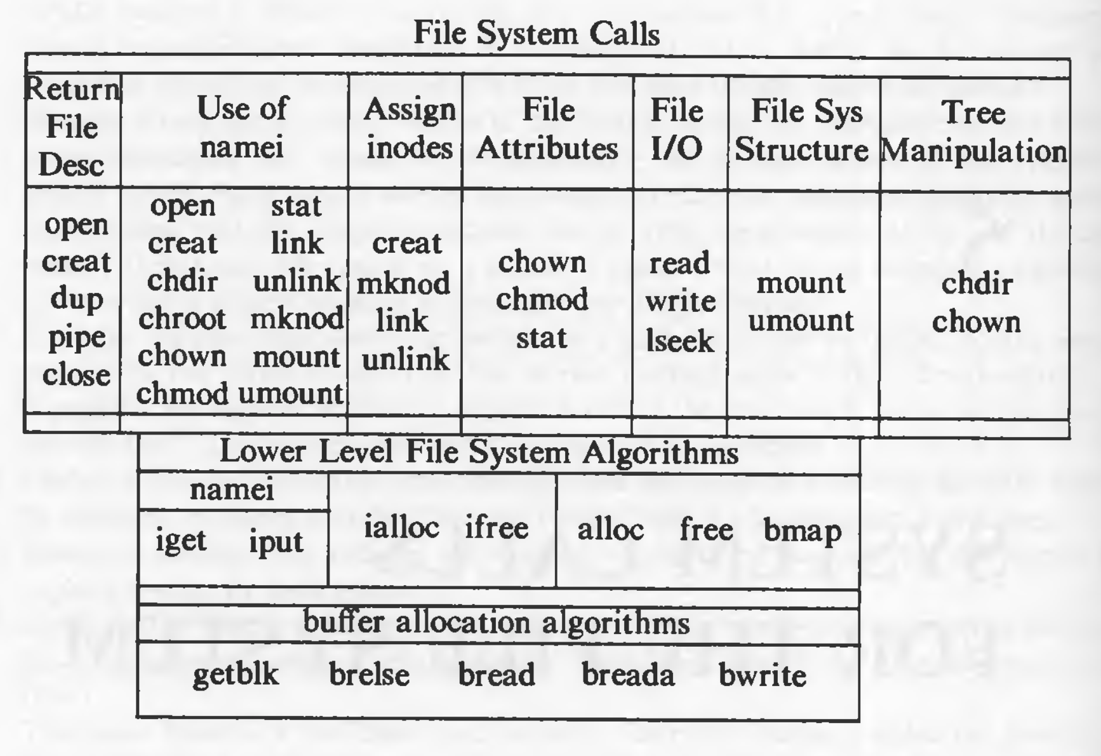
Unix Kernel: File subsystem micro view

Slide 19
Unix Kernel: process control subsystem
The process control subsystem is responsible for process synchronization, interprocess communication, memory management, and process scheduling. The file subsystem and the process control subsystem interact when loading a file into memory for execution. the process subsystem reads executable files into memory before executing them.
The memory management module controls the allocation of memory. If at any time the system does not have enough physical memory for all processes, the kernel moves them between main memory and secondary memory so that all processes get a fair chance to execute.
The scheduler module allocates the CPU to processes. It schedules them to run in turn until they voluntarily relinquish the CPU while awaiting a resource or until the kernel preempts them when their recent run time exceeds a time quantum. The scheduler then chooses the highest priority eligible process to run; the original process will run again when it is the highest priority eligible process available.

Slide 20
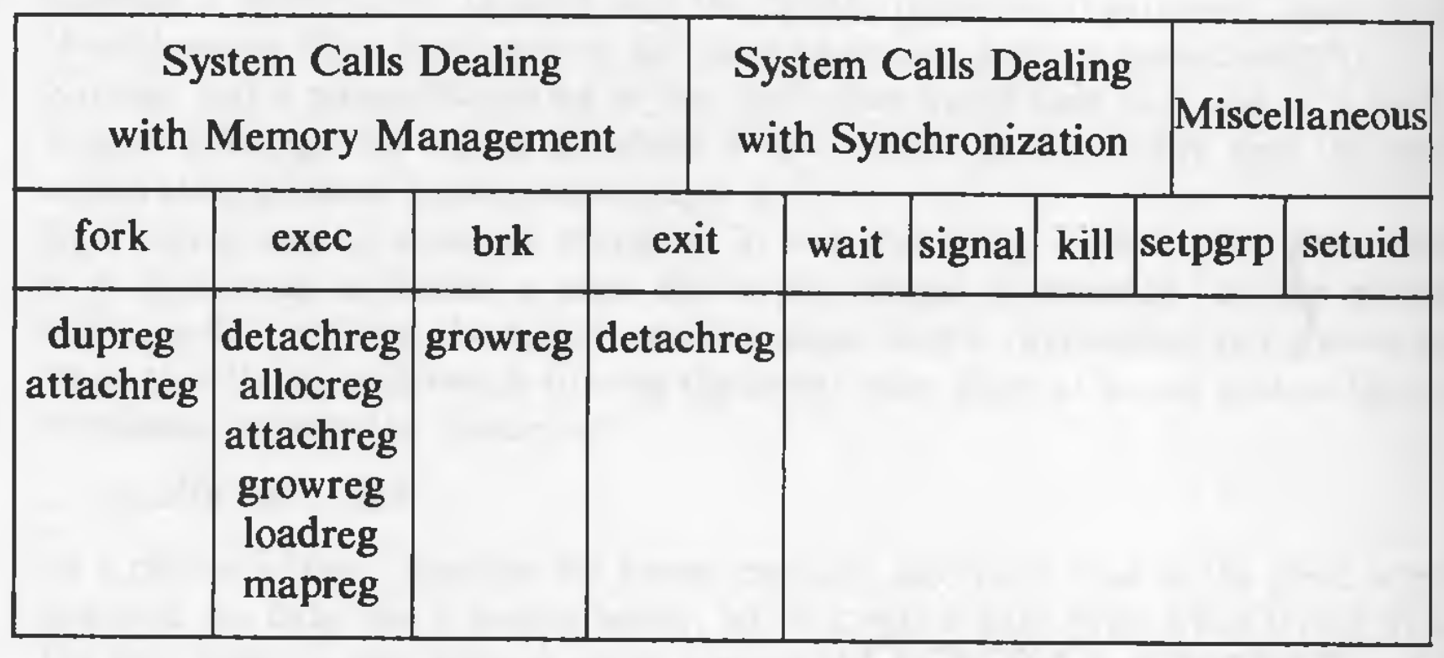
Unix Kernel: Process control sub system micro view

Slide 21
Unix Kernel: interprocess communication
A running Linux system consists of numerous processes, many of which operate independently of each other. Some processes, however, cooperate to achieve their intended purposes, and these processes need methods of communicating with one another and synchronizing their actions. One way for processes to communicate is by reading and writing information in disk files. However, for many applications, this is too slow and inflexible. There are several forms of interprocess communication, ranging from asynchronous signaling of events to synchronous transmission of messages between processes including the following: signals, pipes, sockets, file locking, message queues, semaphores, shared memory.

Slide 22
Unix Kernel: hardware control
Finally, the hardware control is responsible for handling interrupts and for communicating with the machine. Devices such as disks or terminals may interrupt the CPU while a process is executing. If so, the kernel may resume execution of the interrupted process after servicing the interrupt: Interrupts are not serviced by special processes but by special functions in the kernel, called in the context of the currently running process.

Slide 23
To DO
Take a look at course web page in LMS
Take a look at first lab and skilling Exercise
Watch video of next session before attending the class

